Slide 1
Chapter 10
Writing Reports

Slide 2
Icebreaker Discussion
Reports are used throughout the workplace and for various purposes.
What kinds of reports have you written?
Were they mostly text, or were they typically visual presentations – such as PowerPoint slides?
Which is your preference to create and why?
Notes:
Students can also be asked what kind of presentations they have viewed. Do they prefer watching someone who is giving a speech, or presenting information with graphics and other images?

Slide 3
Learning Objectives
After studying this chapter, you should be able to:
10-1 Determine an appropriate report format and organization in a business situation.
10-2 Describe typical components of a business report.
10-3 Explain how the writing style for a report may differ from other types of writing.
10-4 Format a footnote to cite a given source.
10-5 Distinguish design and formatting guidelines for slide decks from other types of reports.

Slide 4
10-1
Planning the Report

Slide 5
10-1 Planning the Report (1 of 5)
Most businesses prefer shorter documents, but decisions affecting people’s lives, the environment, or company profits deserves careful consideration.
Information can be provided in a business report – an organized presentation of the information needed to make decisions or solve a problem.
Notes:
Business report – an organized presentation of information used to make decisions and solve problems.

Slide 6
Figure 1: Criteria for a Business Report
Organized | The reader can locate information quickly. Content is presented in a logical order.
Well supported | The reader can trust the information (facts and data). Where subjective judgments are made, as in drawing conclusions and making recommendations, they must be presented ethically and be based on information presented in the report.
Useful | The reader uses the report to make decisions and solve problems that affect the organization’s success. Unlike some scientific and academic reports, business reports provide practical information that readers use to take action.
Notes:
Figure 1: Criteria for a Business Report from page 322 of the textbook.

Slide 7
10-1 Planning the Report (2 of 5)
Distinguishing Types of Reports
Situational Reports
Created to respond to a unique problem or opportunity
Used once
Start from scratch
Request for Information (RFI)
Ask for general background from potential suppliers
Preliminary report
Request for Proposal (RFP)
Ask for bids on potential work
Formal, detailed document
Outline research plan, timeline, cost
Notes:
Situational report – a document produced once for a unique or specific problem or opportunities.
Request for information - a preliminary document asking for general background from potential suppliers.
Request for proposal - a more formal, detailed document looking for bids.

Slide 8
10-1 Planning the Report (3 of 5)
Selecting a Report Format
Written Report
Traditional audience
Primarily text-based
Narrative (paragraph) format
Headings and subheadings separate each section
Presentation Deck
Progressive Audience
Limited time
Illustrating visual points
Bullet point format
Each page is a section with title as heading
Not for use in an oral presentation
Notes:
Figure 2: Report Formats on p. 324 of the textbook shows various types of forms from less graphical to more graphical.
Figure 3: Short Report in an Email on p. 325 of the textbook shows an example of how a report might appear in email format, with links to specific files that a recipient might review.

Slide 9
10-1 Planning the Report (4 of 5)
Organizing a Report
Findings, Conclusions, and Recommendations
Findings are evidence based and states information collected
Conclusions are drawn from findings and answers research question raised in the introduction
Recommendations are solutions or plans of action to address the problem, based on findings and conclusions
Notes:
Understanding your audience will determine how to present your findings and recommendations. Most American audiences prefer the direct approach, but some international audiences may prefer a more indirect method. The difficulty of the topic being discussed will impact this presentation, as well, as some more complex topics may require more detail or support material to justify the recommendations.

Slide 10
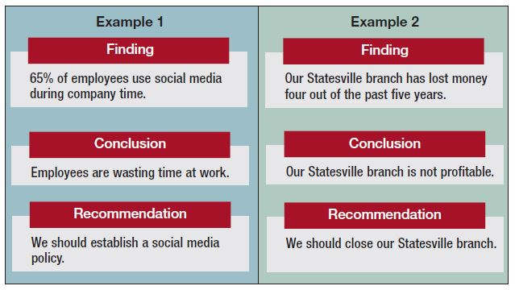
Figure 4 Examples of Findings, Conclusions, and Recommendations
Notes:
Figure 4 Examples of Findings, Conclusions, and Recommendations from p. 326 of the textbook.

Slide 11
10-1 Planning the Report (5 of 5)
Organizing a Report
Organizational Strategies
Time: when it is important for the reader to know the sequence of events
Location: when the geographical or physical location of topics is important
Importance: when drawing attention to important information
Criteria: when analyzing data, drawing conclusions, or making recommendations
Notes:
Time: This method is appropriate for agendas, meeting minutes, schedules, and status reports.
Location: Organizing this way is appropriate for simple information reports when discussing topics related to geographical or physical location spaces, such as describing an office layout.
Importance: For audiences that are extremely busy, importance could be a better method as it addresses the topics based on most important first and least important last. They could read the important portions and skim the less important ones.
Criteria: For topics that require data collection and analysis, criteria may be the best way to lay out the report – develop the hypothesis and break it down based on recommendations or causes of the problem.

Slide 12
Class Discussion 1
How did the author use time, location, importance or criteria?
How could they implement a different strategy?
On Monday morning, I interviewed one candidate for the budget analyst position and two candidates for the junior accountant position. Then, in the afternoon, I interviewed two candidates for the asset manager position and another for the budget analyst position. Finally, on Tuesday, I interviewed another candidate for budget analyst and two for junior accountant.
On Monday and Tuesday, I interviewed three candidates for the budget analyst position, four for the junior accountant position, and two for the asset manager position
Notes:
This activity may take 10-15 minutes.
INSTRUCTIONS:
Have students read and review the two examples from 326 and 327 of the textbook.
Have students pair up to work together to compare the two summaries. What have the authors done to help the reader?
With their partner, brainstorm how the author used time, location, importance, or criteria to organize the report. Discuss, how could they have used a different strategy?
Bring the class together as a whole and allow students to share out their observations.
Potential Answer:
Answers will vary. In the first email (left), it is written in chronological order giving the day and time emphasis. In the second email (right), the emphasis is given to the positions being interviewed, or the importance. They do this by grouping the positions together as one task.
Answers will vary. They could have used criteria to organize the information and rank the candidates. For example: We met with three candidates for the budget analyst position. The first one was very knowledgeable and direct which would make him hard to work with. The second knew her stuff but was very shy and would have difficulty presenting the results she found. The third candidate was very friendly, outgoing and knowledgeable. He might have trouble focusing on the work. While all three candidates had the knowledge necessary to complete the needed tasks, I’m not sure they are right for the culture of our company. We have lined up two more candidates to interview on Thursday.

Slide 13
Class Discussion Debrief
Most of us know someone who prefers to tell a story with extensive detail, such as is used in the first example on the previous slide. Many prefer to hear a story in the shortened version, like the second example.
Which version do you prefer to hear?
In a business situation, when would the first example be more appropriate to use than the second, shorter one?
Notes:
Conduct debrief on discussion with class.
Potential Answers:
Answers will vary.
Some people may prefer to tell a story in detail, especially if it is an exciting event or if the details are of great significance. People may prefer to hear details of a story if it is exciting or dramatic, but many prefer a shorter, to-the-point story.
In business, the detailed list of who was interviewed on which day could be used for tracking purposes, such as to track interest in each position in relation to the job posting, and other details that could be used in planning for future positions or hiring events. The shorter example could be used more for a brief overview of work done through the week in order to gauge workload and scheduling.

Slide 14
10-2
Drafting the Report

Slide 15
10-2 Drafting the Report (1 of 4)
Creating Report Sections
Be consistent throughout
Phrases, questions or sentence titles
Maintain Balance
Similar heading style and format
Equal sections
Equal lengths
Have at least two subsections when using them.
Notes:
Planning how to organize your report can assist your readers in understand what your report covers, helps you to determine what is most important and what subsequent content is needed as support, and helps the reader focus on the sections that pertain to them. Consistency in section headings and length helps the report feel more organized.

Slide 16
10-2 Drafting the Report (2 of 4)
Generic Headings:
Decreasing Heat Loss
Upgrading Exterior Features
Improving Efficiency
Message Titles:
Insulating the Walls and Attic Will Decrease Heat Loss
Replacing the Windows and Doors Will Reduce Air Leaks and Improve Appearance
Installing an Efficient Furnace Will Reduce Fuel Costs
Notes:
Generic headings – identify only the topic of a section without giving a conclusion.
Message titles (or talking headings): identify the main point of the report section or deck page providing the reading with important ideas.
Figure 5: Message Titles Convey an Argument on p. 329 shows the headings for a report recommending a college tuition assistance program and show how the argument progresses.

Slide 17
10-2 Drafting the Report (3 of 4)
Parallelism
Keep your heading style consistent – all full sentences or all phrases
Length and Number of Headings
Shorter is better, but focus more on conveying meaning than on word count
Balance
Balance out the body – number of subsections should be similar
Notes:
Figure 6: Parallel Headings in a Report on p. 329 shows how all headings of a certain level are of a parallel format.

Slide 18
10-2 Drafting the Report (4 of 4)
Drafting the Body
Introduction
Sets the stage
Findings
Discuss and interpret data gathered
Summary and Conclusions
Summary and recommendations (if needed)
Drafting Supplementary Sections
Title Page
Cover Note
Executive Summary
Table of Contents
Appendix
References
Notes:
Executive summary – a condensed version of the body of the report, similar to an abstract in an academic report.
Figure 7: Explaining a Graphic on p. 331 uses multiple graphics and a caption to visualize an article explaining the concept of actual versus recommended intake of vegetables and grains.

Slide 19
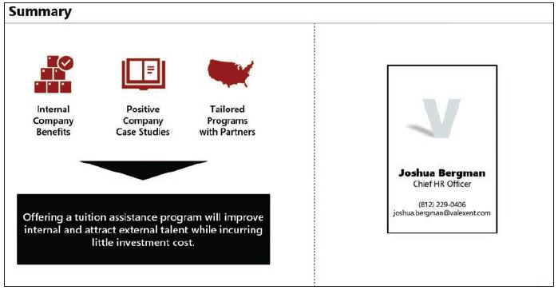
Figure 8: Summary Page for the Tuition Assistance Deck
Notes:
Figure 8: Summary Page for the Tuition Assistance Deck on p. 332 shows an overall summary slide for the tuition assistance program described in Figure 5.

Slide 20
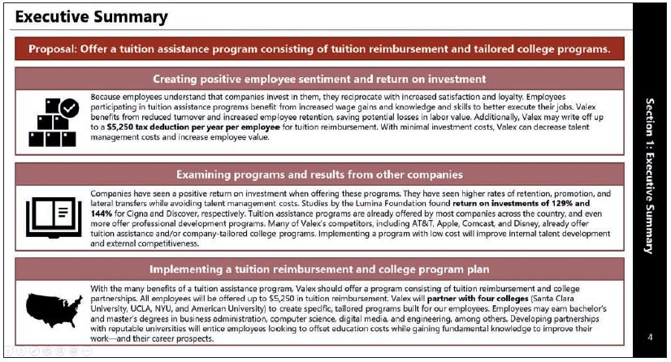
Figure 9: Executive Summary of the Tuition Assistance Deck
Notes:
Figure 9: Executive Summary of the Tuition Assistance Deck on p. 333

Slide 21
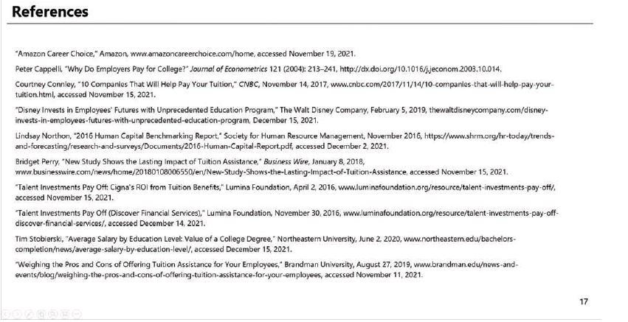
Figure 10: Reference Page for the Tuition Assistance Deck
Notes:
Figure 10: Reference Page for the Tuition Assistance Deck p. 334.

Slide 22
Class Discussion Activity 2
Review the entries in Figure 10. How does providing this information support the argument of the tuition assistance proposal discussed in several figures?
Notes:
This activity may take 10-15 minutes.
INSTRUCTIONS:
Have students review Figure 10 from p. 334.
What stands out in the entry information that would be useful in the argument for the benefits of tuition reimbursement.
Potential Answer:
1. Answers will vary. The information provided in the References are all recent articles, which shows that the data collected is recent and not outdated. It also shows large companies (such as Amazon and Disney) that see the value in education and in supporting their employees.

Slide 23
Class Discussion Activity 2 Debrief
Viewing the examples throughout this section, how do you feel the organization, layout, and content supports the argument for tuition assistance?
Notes:
Conduct debrief on discussion with class.
Potential Answers:
Answers will vary. Figure 5 shows an outline of the main headings in the discussion, showing that there are benefits for employees and employers, and gives examples of high-level companies that utilize the assistance. Figure 8 outlines a summary of the entire presentation, along with a final recommendation and reasoning for support to implement the program. Figure 9 provides the detail from the Executive Summary, which is the main page leaders will review to get an overall feeling for the financial impact as well as the benefits. Figure 10 shows where the data was pulled from and validates that the data used was current and applicable.

Slide 24
10-3
Developing an Effective Writing Style

Slide 25
10-3 Developing an Effective Writing Style (1 of 2)
Tone
Consider context
Use a professional, natural writing style
Avoid: colloquial expressions, bias, subjectivity, and exaggeration.
Pronouns
Focus on the information
Use third person
Avoid overusing passive voice
Notes:
Writing style conveys a lot in a report. Tone can convey the seriousness or lighthearted intent of the communication as well as make the report formal or informal, active or passive.

Slide 26
10-3 Developing an Effective Writing Style (2 of 2)
Verb Tense
Match the tense to the reader’s situation
Explain data in the present tense
do not use outdated data
Emphasis and Subordination
Shows level of importance
Organize multiple conclusions
Coherence
Create a unified report
Use previews, summaries, and transitions
Read smoothly without headings
Stacked headings
Section overview
Include introduction before sections
Notes:
Verb tense should be appropriate for when the reader is reading the report.
Stacked headings: one heading followed by another without some intervening text.
Section overview: a preview of how the topic will be divided and highlight main points before making the division.

Slide 27
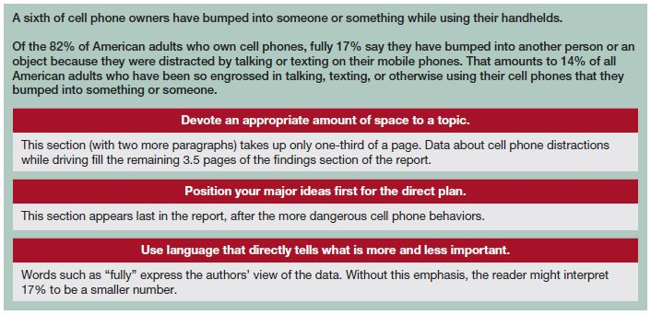
Figure 11: How Authors Use Emphasis and Subordination
Notes:
Figure 11: How Authors Use Emphasis and Subordination from page 336 of the textbook

Slide 28
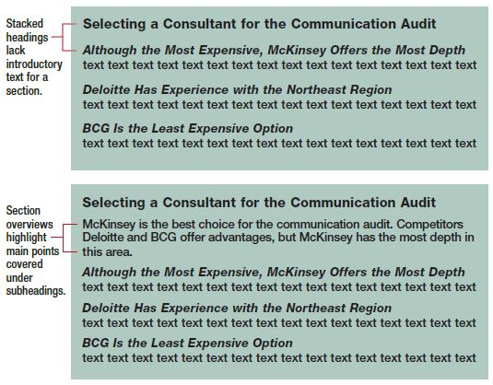
Figure 12: Avoiding Stacked Headings with Section Overview
Notes:
Figure 12: Avoiding Stacked Headings with Section Overview on page 337 of the textbook.
Stacked headings – one heading following another without some intervening text.
Section overview - a preview of how the topic will be divided and highlight main points before making the division.

Slide 29
Class Discussion 3
How has the author used previews, summaries, and transitions in these two paragraphs?
Training System Users
The training program can be evaluated in two ways: user opinion and training cost as a percentage of total system costs. . . . (After this topic preview, several paragraphs follow that discuss the users’ opinions and the cost of the training program.)
Even though a slight majority of users now feel competent in using the system, the training falls far short of the 20% of total system cost recommended by experts. This low level of training may have caused the high rate of system errors. (The first sentence summarizes this section, and the second provides a transition to the next.)
Notes:
This activity may take 10-15 minutes.
INSTRUCTIONS:
Have students read and review the excerpt from page 337 of the textbook [also displayed in the slide].
Have students pair up to work together to answer the questions and find specific examples:
How has the author used previews, summaries, and transitions in these two paragraphs?
How does the preview, summary, and transition add coherence to the writing?
Bring the class together as a whole and allow students to share out their observations.
Excerpt found on page 337 of the textbook.
Potential Answers:
Answers will vary. The author used preview in the first paragraph by stating “can be evaluated in two ways” and then naming them. This gives the reader an idea of what is coming. The author used summary by generalizing the data with phrases like “the majority” and “falls short” for easy reading and a general overview before going into the statistics and details that support these statements. Finally, the author used transitions to connect the cause and effect of the problem with poor training to system errors.

Slide 30
Class Discussion 3 Debrief
Can you think of an article or report you have read that did not include different headings or parts? Were you able to follow along with the document or did you have trouble understanding it?
Notes:
Conduct debrief on discussion with class.
Potential Answers:
Some students may have read reports that are less organized than what is being described. The lack of transitions could cause confusion if the writer is shifting to another topic. Not having section headers also requires that the audience reads every section, even if it does not impact their work. By adding sections, people can skim over the document and read only what is important to their work. In today’s fast-paced work environment, this can be critical.

Slide 31
10-4
Documenting Your Sources

Slide 32
10-4 Documenting Your Sources (1 of 2)
Why We Document Sources
Using secondary sources is common in business
To prevent accusations of plagiarism by providing documentation
What Must Be Documented
Paraphrase or direct-quote of others’ thoughts
How to Document Sources
Footnotes, endnotes and author-date references are common because they do not interrupt the flow of the report.
Follow Harvard Business School Citation Guide or The Chicago Manual of Style for citation rules
Notes:
Plagiarism – using another person’s words or ideas without giving proper credit.
Documentation – identifying sources by giving credit to others, either in the text or a reference list.
Paraphrase – a summary or restatement of a passage in your own words.
Direct quotation – contains the exact words of someone else enclosed within quotation marks.

Slide 33
Figure 13: Poorly Paraphrased Text from an Online Tool
Original text | Her case became suspicious to the department after her mental health deteriorated shortly after she started working in the position.
Paraphrased text by an online tool | Her case got dubious to the office after her psychological well-being disintegrated not long after she began working in the position.
Paraphrased text by a human | When department managers noticed mental health issues, they questioned her job qualifications. OR After the employee suffered increasing mental health issues, her initial application came into question.
Notes:
Figure 13: Poorly Paraphrased Text from an Online Tool on page 339 of the textbook.

Slide 34
10-4 Documenting Your Sources (2 of 2)
How to Avoid Distortion by Omission
Be aware of distorting information or omitting data
Do not take quotes out of context
Do not omit relevant information
Do not cherry pick favorable data
Do not imply one comment represents a whole group
Keep the persons original intention in mind
Carefully quote or paraphrase
Notes:
Everyone knows people make mistakes, but the more documentation you can provide and the more accurate your data, the better position you will be in to defend minor mistakes. Using data in pieces or omitting information can call into question your character and your ethics.
Figure 14: How to Format Sources in Footnotes p. 340 of the textbook.

Slide 35
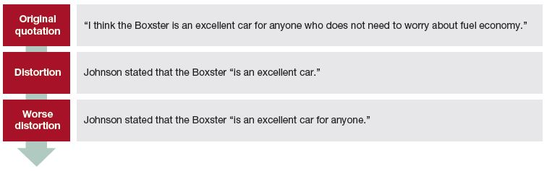
Figure 15: Distortions of an Interview Statement
Notes:
Figure 15: How to Format Sources in Footnotes on page 339 of the textbook.

Slide 36
Group Activity
Why is it important to document sources?
How does documenting sources reflect on you as a professional or your company?
What are possible implications of not documenting sources?
Notes:
Group activity may take 10-20 minutes
INSTRUCTIONS:
Have students break into small groups of three to five people.
Read through the discussion questions.
Discuss your thoughts within your group.
Collectively choose the most compelling answers to the questions.
Share your thoughts with the larger group.
Potential Answers:
Answers will vary. It is important to document sources so that you are giving credit to those who did the work originally.
Answers will vary. Documenting sources helps to build your credibility. It shows that you are an honest person willing to give credit where it is due. It also shows that you are willing to research what you don’t know and validates that your data and conclusions are based on current data.
Answers will vary. If sources are not documented, there is no way to check information that may be incorrect or misconstrued. It can also be seen as trying to hide information or being dishonest and make audiences question other materials and your ethics. It can also lead to accusations of plagiarism.

Slide 37
Group Activity Debrief
The use of quotes can be a great benefit to research you have conducted, but it is important to ensure that the quote is accurate.
Considering the technology currently available today, how has it become easier to prove the accuracy of a statement someone said?
Notes:
Conduct debrief on discussion with class.
Potential Answer:
The use of photo and video on cell phones, wireless microphones, and other recording devices make it easier to record a situation for reference and playback later. It can be crucial evidence to prove someone said or did something that they denied. Some complications can be distorted video, background noise muffling what is said, and movement distorting the images. Items such as body cameras on police officers and bystander videos have been important pieces of evidence in criminal cases. People should take care, however, to ensure that recording others does not violate any privacy rights, so meetings and discussions that are being recoded are often advised to be disclosed to the people attending.

Slide 38
10-5
Designing, Formatting, and Refining
the Report

Slide 39
10-5 Designing, Formatting, and Refining the Report (1 of 6)
Designing and Formatting Text-Based Reports
Graphics
Precede with an interpretation paragraph
Should complement report
Utilize figure and table numbers
Keep figures and tables together.

Slide 40
10-5 Designing, Formatting, and Refining the Report (2 of 6)
Designing and Formatting Text-Based Reports
Spacing and Fonts
One-inch margin and single-spaced
Left justify
Single line space between paragraphs
Standard fonts and sizes.
Distinguish major and minor headings

Slide 41
10-5 Designing, Formatting, and Refining the Report (3 of 6)
Designing and Formatting Text-Based Reports
Headers, Footers, and Page Numbers
Report title and page number on each page
May include date, writer, organization, or copyright
Body: Arabic numbers
Preliminary pages: lower case Roman numerals

Slide 42
10-5 Designing, Formatting, and Refining the Report (4 of 6)
Designing and Formatting Slide Decks
Graphics
Avoid dark-colored backgrounds; accent with dark-colored text boxes
Avoid using too many colors.
Use colors in a meaningful way: signal connections, progression, contrasting ideas
Avoid color combinations that may be problematic for some readers
Print a test page
Notes:
Figure 16 can be found on the next 3 slides.
Figure 17: Guidelines for Creating a PowerPoint Report Page on p. 344 shows how colors and bullets are used to connect points and add visual interest.

Slide 43

Figure 16: Deck Density for Different Purposes and Audiences (1 of 3)
Individual reading (one person at an individual pace)
Most slide density
Least Presentation Formality
Notes:
Figure 16: Deck Density for Different Purposes and Audiences page 343 of the textbook.

Slide 44

Figure 16: Deck Density for Different Purposes and Audiences (2 of 3)
Discussion or sales pitch (small group at a varied pace)
Mid slide density
Mid Presentation Formality
Notes:
Figure 16: Deck Density for Different Purposes and Audiences page 343 of the textbook.

Slide 45
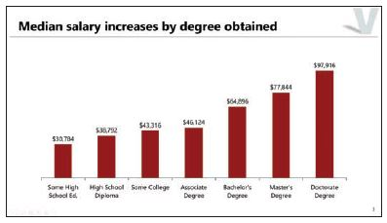
Figure 16: Deck Density for Different Purposes and Audiences (3 of 3)
Presentation or briefing (larger group at a set pace)
Least slide density
Most Presentation Formality
Notes:
Figure 16: Deck Density for Different Purposes and Audiences page 343 of the textbook.

Slide 46
10-5 Designing, Formatting, and Refining the Report (5 of 6)
Designing and Formatting Slide Decks
Fonts, Spacing, and Page Numbers
Use consistent fonts and sizes for titles, subheadings, and body text
Use the same size for all message titles
Subheadings are smaller; use the same size for all subheadings
Use the same size for similar body text
Limit fonts to two choices
Use sentence case
Insert page numbers; omit numbers for title page and table of contents
Notes:
Design and layout can be critical to readability. Having a report that has too many fonts or hard-to-read fonts can become distracting to readers, as well as confusing. Headers and footers can help with keeping pages together and in sequence if they somehow become separated.

Slide 47
10-5 Designing, Formatting, and Refining the Report (6 of 6)
Refining Your Report
Revising
Revising is a process, take your time
Revise for content
Revise for style
Revise for correctness
Proofread
Mistakes reflect the writer
Appearance and details count
Check for blank lines, extra page breaks, inconsistent use of fonts and colors, misused words, inconsistent punctuation
Notes:
All written files should be reviewed at least once, but preferably more, to ensure it is clear and error free. Errors can become distracting and can cause lack of faith in the writer’s skills if a lot of errors are discovered.

Slide 48
Figure 18: Steps for Revising
1. Revise for content. | Have you included sufficient information to support each point? Have you excluded extraneous information (regardless of how interesting it might be or how hard you worked to gather the information)? Is all information accurate? Is the information presented in an efficient and logical sequence?
2. Revise for style | Are words clear, simple, and concise? Are you using a variety of sentence types? Do your paragraphs have unity and coherence, and are they of reasonable length? Have you maintained an overall tone of confidence, sincerity, and objectivity? Have you used appropriate emphasis and subordination?
3. Revise for correctness | Do you find any errors in grammar, spelling, punctuation, and word usage? Does a colleague catch any errors you may have overlooked?
Notes:
Figure 18: Steps for Revising on page 345 of the textbook.

Slide 49
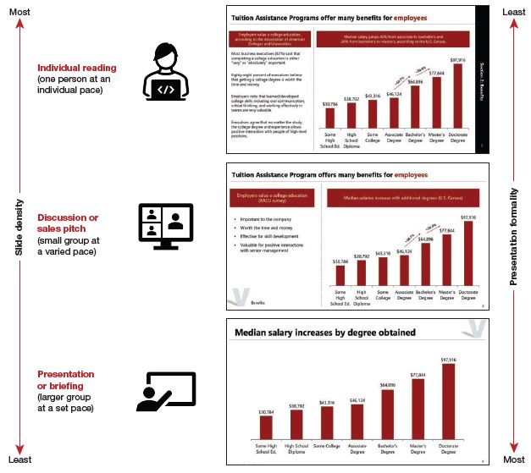
Class Discussion Activity 4
Compare and Contrast the three slides in Figure 16.
How does the design change for the audience?
How does the design support the audiences understanding of the information?
How does the design support the purpose of the event?
Notes:
This activity may take 10-15 minutes.
INSTRUCTIONS:
Have students read and review the two summaries from the individual and discussion slides shown in Figure 16: Deck Density for Different Purposes and Audiences page 343 of the textbook (enlarged images provided in earlier slides, as well.)
Have the class share their observations.
Figure 16: Deck Density for Different Purposes and Audiences page 343 of the textbook.
Potential Answers:
Answers will vary. The slide deck becomes more and more visual the more support the audience will be getting. The less they will be receiving outside of the slides, the more is included on them.
Answers will vary. The slide deck for the individual to review has a lot more wording and information. The individual needs to be able to read the important information because the slides are the only source for the information. The slide deck for a presentation is very visual. It provides a little information that can quickly be viewed and understood. Most of the information in a presentation is being shared by the speaker so the audience member needs to be able to listen. There are not a lot of words that need to be read that will conflict with their listening comprehension. In the middle, there are bullet points that offer a little less information than the individual as they are still listening. However, the bullets provide a little more information than the presentation to job the audience members memory when reviewing afterwards.
Answers will vary. The slides support the purpose of the event by allowing the audience to focus on the information and event. Without a lot of visuals, they can listen without distractions. However, without anyone to interpret, they still have all the information to read and understand the slides. Similarly, with an event where people will be reviewing the information later, independently, the slide offers enough information to comprehend it on their own and remember key details that were discussed.

Slide 50
Class Discussion 4 Debrief
Today’s world of telecommunication involves meetings held online and, in some cases, the presentation is provided to people separately.
Considering that part of your audience will review the slides during the presentation, and some will not, how would you approach the creation of your slide deck?
Notes:
Conduct debrief on discussion with class.
Potential Answer:
Answers will vary. Students can suggest plans to either use a hybrid format of slides – putting enough information that people can read the slides and understand the information, or they can possibly provide notes for support in the slides. Another option could be to create a separate slide deck to be posted for viewing without a recorded presentation.

Slide 51
Checklist for Reviewing Your Report Draft (1 of 3)
Introduction and Supplementary Pages
Is the report title accurate and descriptive?
Does the introduction convey the main points?
Does the executive summary provide a comprehensive overview of the report?
Is the table of contents accurate, with correct page numbers and wording that matches the report headings?
Is appendix material labeled and referred to in the body of the report?
Findings and Organization
Is the data analyzed completely, accurately, and appropriately.
Is the analysis free of bias and misrepresentation?
Is the data interpreted (its importance and implications discussed) rather than just presented?
Are the sections logically divided and sequenced?
Does each major section contain a preview, summary, and transition?
Are the headings descriptive, parallel, and appropriate in number?
Are headings and subheadings clearly distinguished?
Notes:
Checklist for Reviewing Your Report Draft on page 346 of the textbook.

Slide 52
Checklist for Reviewing Your Report Draft (2 of 3)
Writing Style and Tone
Is the report appropriately tailored to the audience?
Are emphasis and subordination used effectively?
Has proper verb tense been used throughout?
Has an appropriate level of formality been used?
Summary, Conclusions, and Recommendations
Is the wording used in the summary consistent with that used initially to present the data?
Are the conclusions drawn supported by ample, credible evidence?
Do the conclusions answer the questions or issues raised in the introduction?
Are the recommendations reasonable in light of the conclusions?
Does the report end with a sense of completion and convey an impression that the project is important?
Notes:
Checklist for Reviewing Your Report Draft on page 346 of the textbook.

Slide 53
Checklist for Reviewing Your Report Draft (3 of 3)
Design and Format
Have the principles of document design been followed?
Does the report include appropriate graphics, and are the graphics explained sufficiently in the text?
Are graphics correct, clear, appropriately sized and positioned, and correctly labeled?
Is the report free from spelling, grammar, and punctuation errors?
Are the sources properly documented and consistently formatted?
Does the report make a positive impression overall?
Notes:
Checklist for Reviewing Your Report Draft on page 346 of the textbook.

Slide 54
Knowledge Check
What do you need to consider when choosing a report format? Indicate if each trait should be in a Written Report or Presentation Deck.
Progressive Audience
Primarily text-based
Illustrating visual points
Traditional Audience
Bullet point format
Each page is a section with title
Limited time
Narrative format
Section by heading and subheading
Notes:
Progressive Audience – Presentation Deck
Primarily text-based – Written Report
Illustrating visual points – Presentation Deck
Traditional Audience – Written Report
Bullet point format – Presentation Deck
Each page is a section with title – Presentation Deck
Limited time – Presentation Deck
Narrative format – Written Report
Section by heading and subheading – Written Report

Slide 55
Summary
Click the link below to review the objectives for the presentation.
Link to Objectives

